Slide 1
Are you moving predictably?
Notes:
Changing title -> Are you moving predictably? Marionette und dann durchschneiden

Slide 2
Zusammenfassung der Daten
Welche Attribute
Verteilung
Ziel des Clusterings
Strata reproduzieren
6 Stratas
Mehrere Zusammengefasst
Eigenes Cluster finden
Was haben wir gemacht
Testdaten ( Verteilung und Vector)[Python]
Rapidminer
Clustering [Gower]
PCA[Zeitgewinn aber selbes Erg.]
Decision Tree
NN
Was haben wir nun?

Slide 3
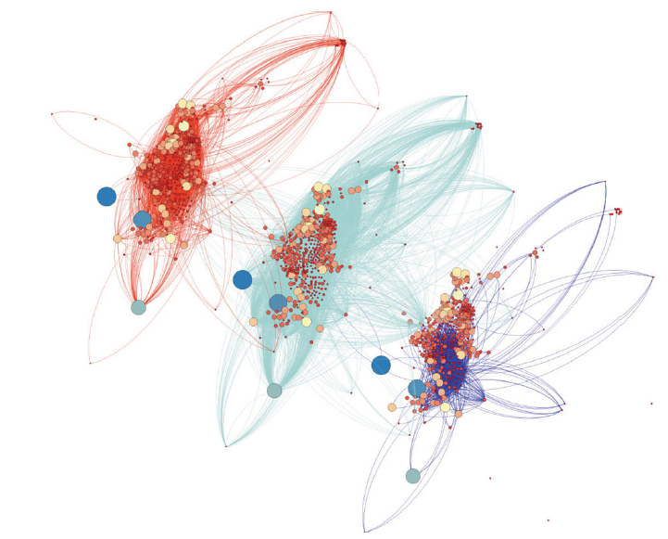
Problem definition
„Based on the paper of Loter et al. we analyzed the movement data of Medellín. Their movements, of six socio-economic groups, are given with, for example, the endpoints of travelling, reason, or means of transportation, as well as personal information, like gender or age.
The task is to find dependencies between these entries and the socioeconomic group of that person.“
Lotero, Laura, et al. "Rich do not rise early: spatio-temporal
patterns in the mobility networks of different socio-economic classes."
Notes:
-MEDELLIN, Columbia -strata is explained from the city and also used for pay taxes

Slide 4
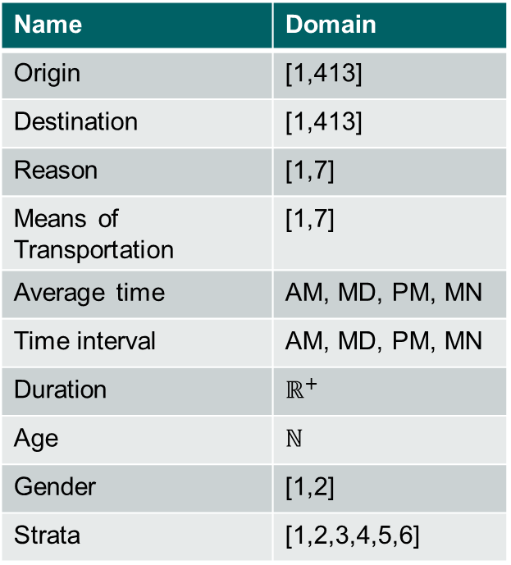
Available Data – What does it look like?
Name | Domain
Origin | [1,413]
Destination | [1,413]
Reason | [1,7]
Means of Transportation | [1,7]
Average time | AM, MD, PM, MN
Time interval | AM, MD, PM, MN
Duration | $$ℝ^{+}$$
Age | ℕ
Gender | [1,2]
Strata | [1,2,3,4,5,6]
Notes:
-Origin, Destination are sectors of the city (DON’T say nodes)

Slide 5

Aim of investigation – What should we do?
Reproduce the stratas
Aggregated stratas
Look for own clusters
?
Data
Cluster
Strata
Strata 1-2
Strata 3-4
Strata 5-6
Strata 1
Strata 3
Strata 5
Strata 2
Strata 4
Strata 6
Notes:
Compare clusters with strata
Too fine classification?
Different visualizations Changing the second title (Method of investigation
How is the clustering measured
This is the index -> numbers and saying that we will explain this the rest of the presentation more in detail

Slide 6
Procedure – What have we done?
1
2
3
4
Evaluate results and adapt process
Take a look at the data
Investigate distance measures and data distribution
Run Clustering algorithms
Notes:
Taking a closer in the data! Visualize it

Slide 7
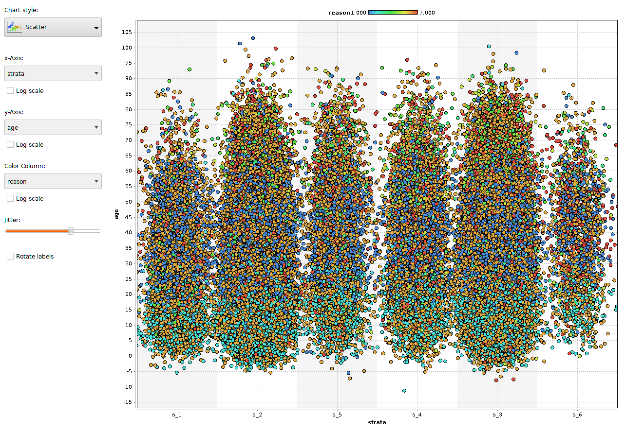
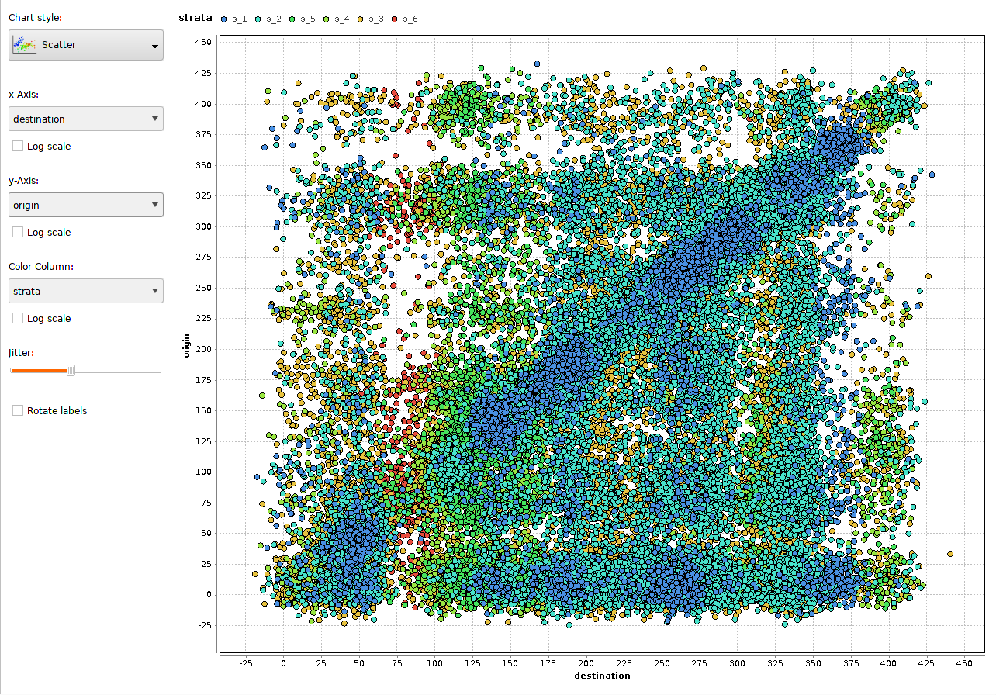
Dig in data – Can we see something?
Notes:
Taking a closer in the data! Visualize it

Slide 8
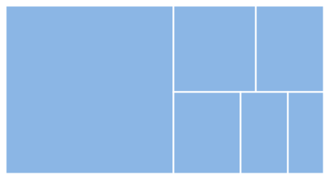
Procedure – What have we done?
Testdata-Generator
Equal distribution
Resize dataset

Slide 9
Encountered Problem
Movement 1
Movement 3
Movement 5
Movement 2
Movement 4
Notes:
More details with explanation!
Changing movements to lines of data and connnect them with the persons

Slide 10
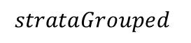
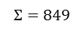
Procedure – What have we done?
Testdata-Generator
Vector data set
Aggregated vector data set
$$o_{1},…{,o}_{413},d_{1},…{,d}_{413},AM,MD,PM,MN,r_{1},…{,r}_{7},MoT_{1},…,MoT_{7},S_{Dest}, S_{Dist},G, A, strata$$
413
413
4
7
7
5
$$Σ=849$$
Also add:
$$strataGrouped$$
Strata 1-2
Strata 3-4
Strata 5-6
Strata 1
Strata 3
Strata 5
Strata 2
Strata 4
Strata 6
Notes:
Dummy variable?

Slide 11
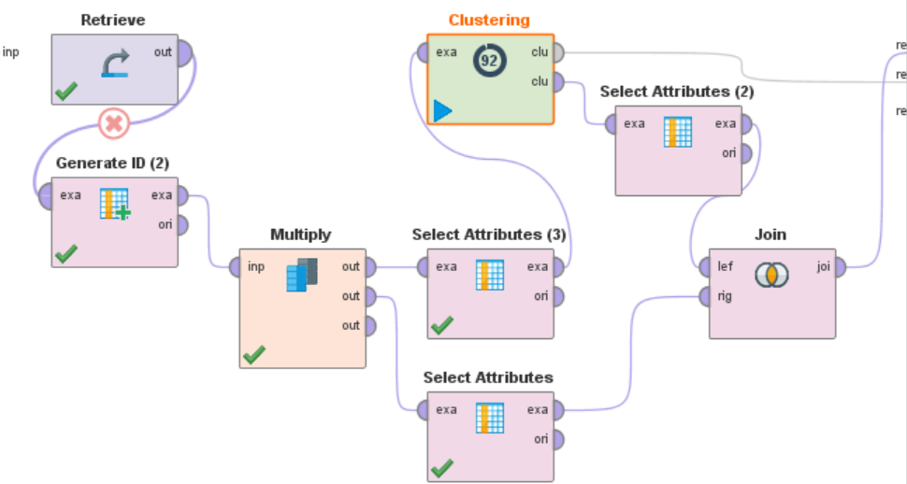
Rapidminer
k-means clustering

Slide 12
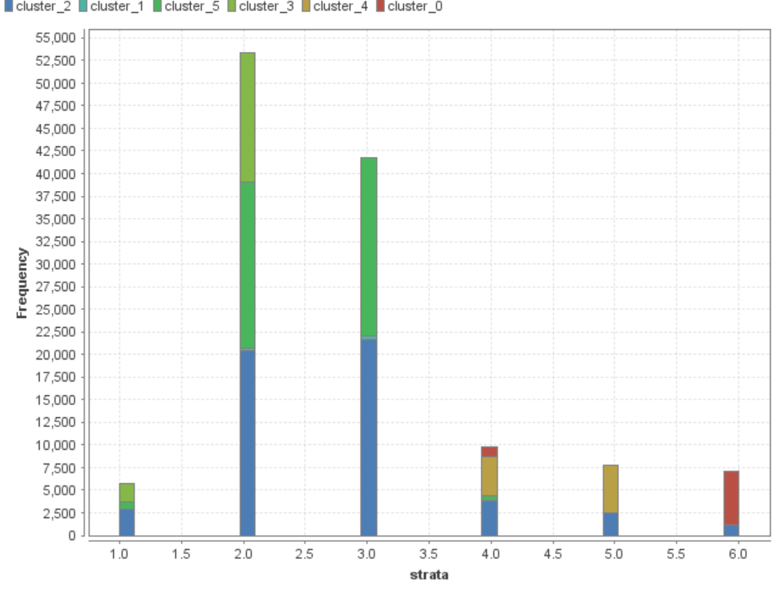
Rapidminer
k-means clustering
Notes:
For measuring also dist2038eq foto

Slide 13
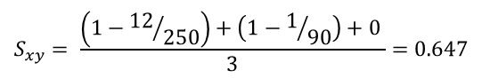
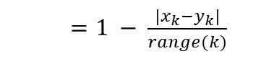
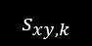
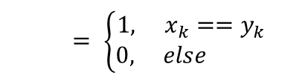
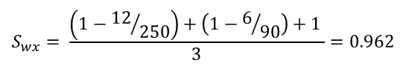
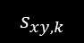
Gower Distance
Example:
Similarity score based on variable type
 | travelDist | age | gender
w | 87 | 40 | M
x | 98 | 46 | M
y | 110 | 45 | F
z | 16 | 25 | F
Binary (irrelevant for our data)
Categorical
Numerical
$= \left\{\begin{aligned}1, x_{k}==y_{k} \\ 0, else \end{aligned}\right.$
$$s_{xy,k}$$
$$S_{wx}= \frac{\left(1−{12}/{250}\right)+\left(1−6/{90}\right)+1 }{3}=0.962$$
$=1 − \frac{|x_{k}−y_{k}|}{range(k)}$
$$s_{xy,k}$$
$$S_{xy}= \frac{\left(1−{12}/{250}\right)+\left(1−1/{90}\right)+0 }{3}=0.647$$
$range(k)$ depicts the range of relevant values for variable $k$, e.g. age $∈\{0, …,90\}$
Notes:
Man sieht, welchen starken Einfluss kategorische Variablen (wie gender) haben. Die Similarity von x,y ist recht gering, trotz ähnlicher Werte. Die Punkte y,z sind sich laut gower ähnlicher, obwohl im Grunde nur das Geschlecht wirklich übereinstimmt.

Slide 14
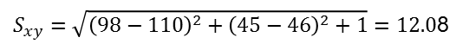
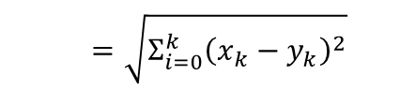
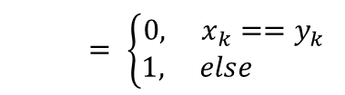
Mixed Euclidean Distance (MED)
Example:
similarity score based on variable type
 | travelDist | age | gender
w | 87 | 40 | M
x | 98 | 46 | M
y | 110 | 45 | F
z | 16 | 25 | F
Binary (irrelevant for our data)
Categorical
Numerical
$= \left\{\begin{aligned}0, x_{k}==y_{k} \\ 1, else \end{aligned}\right.$
$$s_{xy,k}$$
$$S_{wx}=\sqrt{{\left(87−98\right)}^{2}+{\left(40−46\right)}^{2}+0}=13.42$$
$=\sqrt{Σ_{i=0}^{k}{\left(x_{k}−y_{k}\right)}^{2}}$
$$s_{xy,k}$$
$S_{xy}=\sqrt{{\left(98−110\right)}^{2}+{\left(45−46\right)}^{2}+1}=12.0$8
$range(k)$ depicts the range of relevant values for variable $k$, e.g. age $∈\{0, …,90\}$
Notes:
Man sieht, welchen starken Einfluss kategorische Variablen (wie gender) haben. Die Similarity von x,y ist recht gering, trotz ähnlicher Werte. Die Punkte y,z sind sich laut gower ähnlicher, obwohl im Grunde nur das Geschlecht wirklich übereinstimmt.

Slide 15
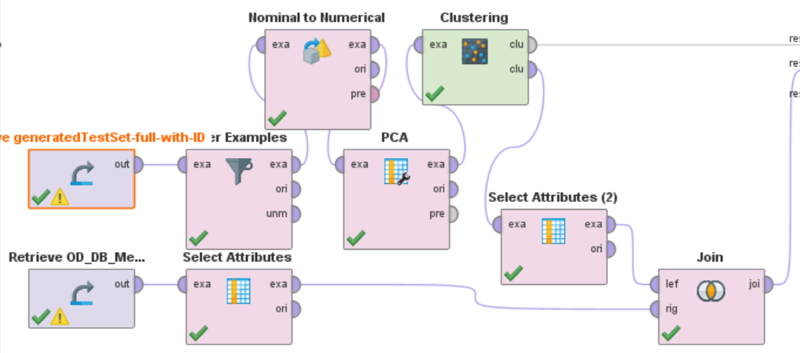
Rapidminer
PCA k-means clustering
Notes:
Principal component analysis -> reduce dimensionality of dataset
Nominal to numerical -> binary in 4 rows

Slide 16
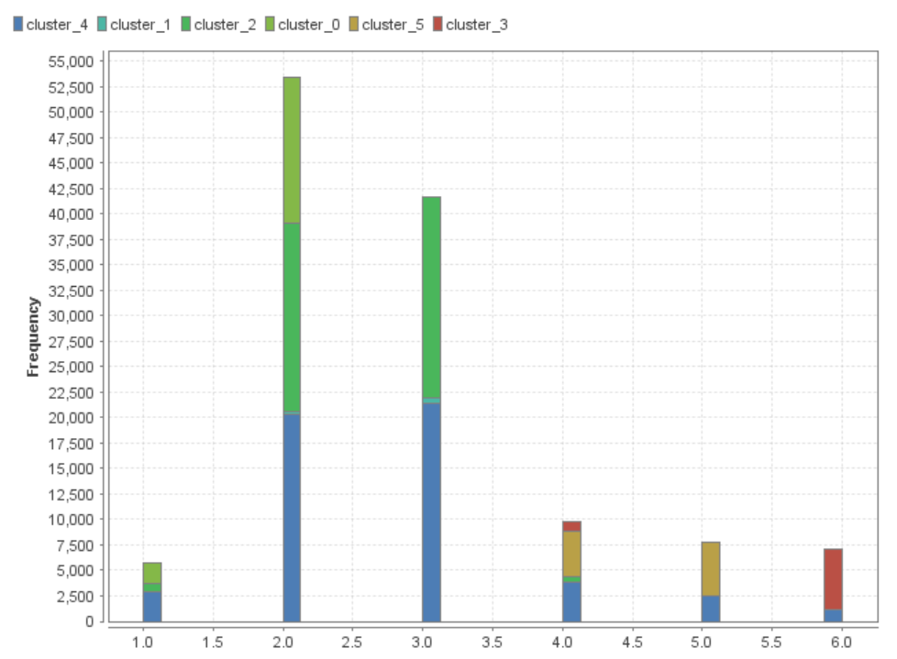
Rapidminer
PCA k-means clustering

Slide 17
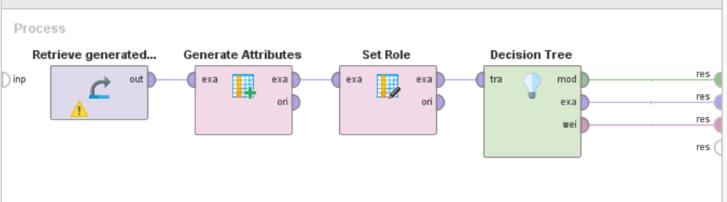
Rapidminer
decision tree

Slide 18
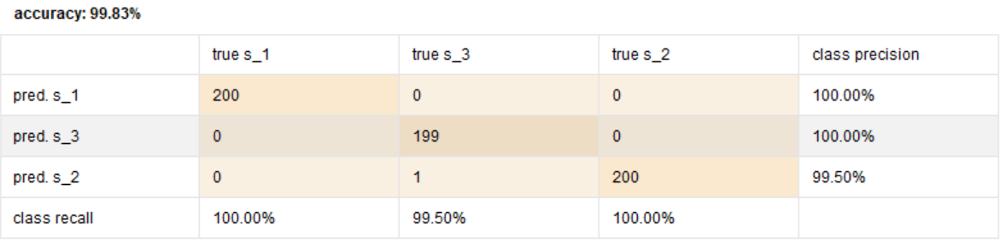
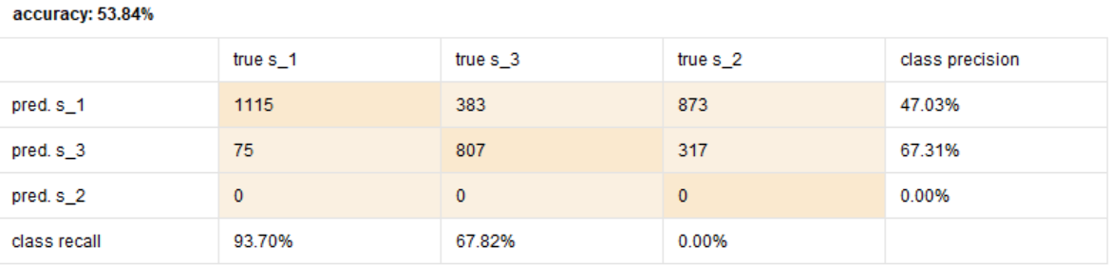
Rapidminer
decision tree
Notes:
Include the weights for the good one

Slide 19
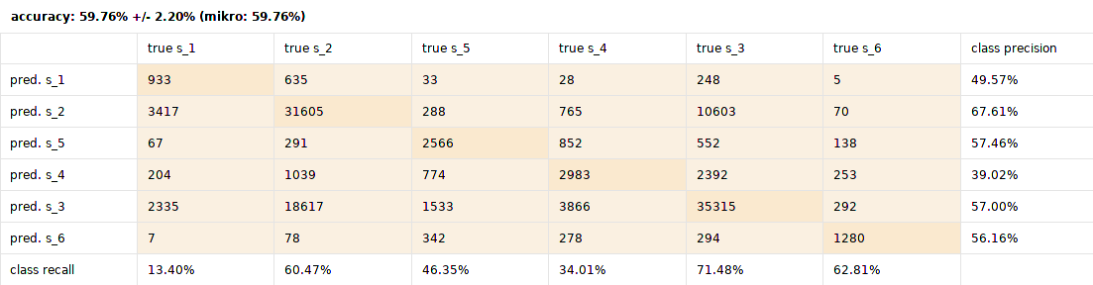
Neural Net
original data:
(in roughly 25 minutes)

Slide 20
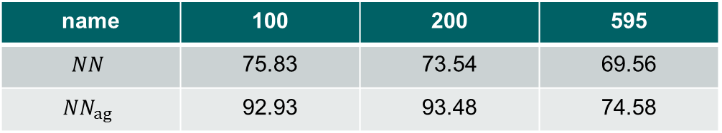
Neural Net
person vector data:
Architecture:
4 Hidden Layers
10 neurons each
Why? Others were worse
What does that tell us? no clear correlation larger set leads to higher variance
name | 100 | 200 | 595
$$NN$$ | 75.83 | 73.54 | 69.56
$$NN_{ag}$$ | 92.93 | 93.48 | 74.58
Notes:
Accuracy has to stand there somewhere
10-fold cross validated

Slide 21

Result
Not reproducable – Why?
Representative working day
People living over/under standards
Individuality of lifestyle
Complete inverse behavior in same strata
No observable clusters
Notes:
NOT SAY HIPSTER Idiot!
We need more information to explain the strata -> summarize

Slide 22
Fin.
Thank you for your attention
Notes:
One slide with: we need more information!

Slide 23
TODOs
Possible additions
calculate proportions of MED und G-Dist to show equal outcome
Through PCA just 2 components. Maybe therefore 2 Cluster?
Analyse most important aspect of DT and NN
Distribution of values within one strata !!
Maybe use networkx
Questions towards María:
Should we explain: k-means?
Notes:
Future work 3 and 5

